Slide 1


Simply But Beauty Data Visualization
with R & ggplot2
Aep Hidayatuloh
Data Analyst at StarCore Analytics
Email: aephidayatuloh.mail@gmail.com

Slide 2
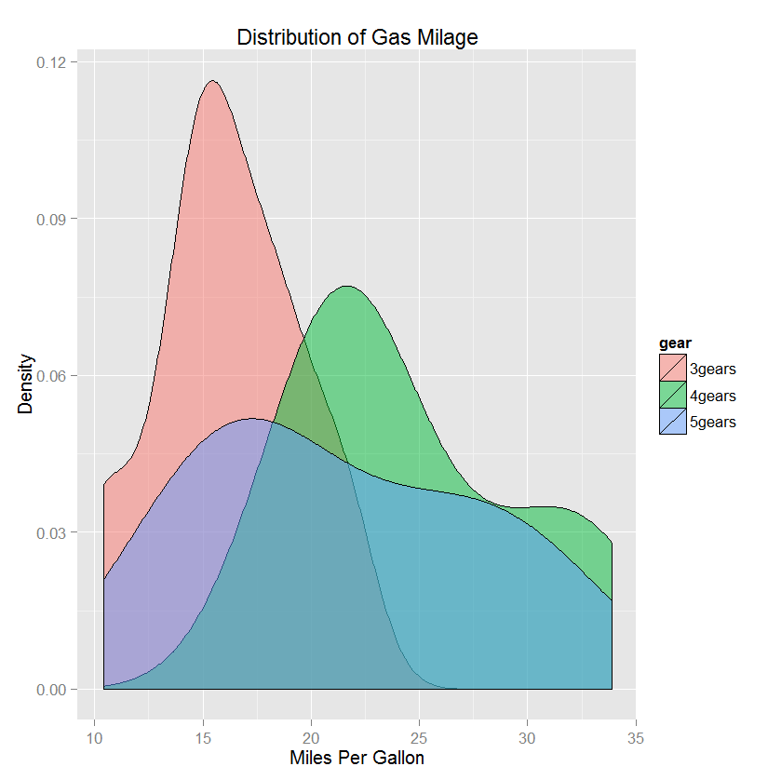
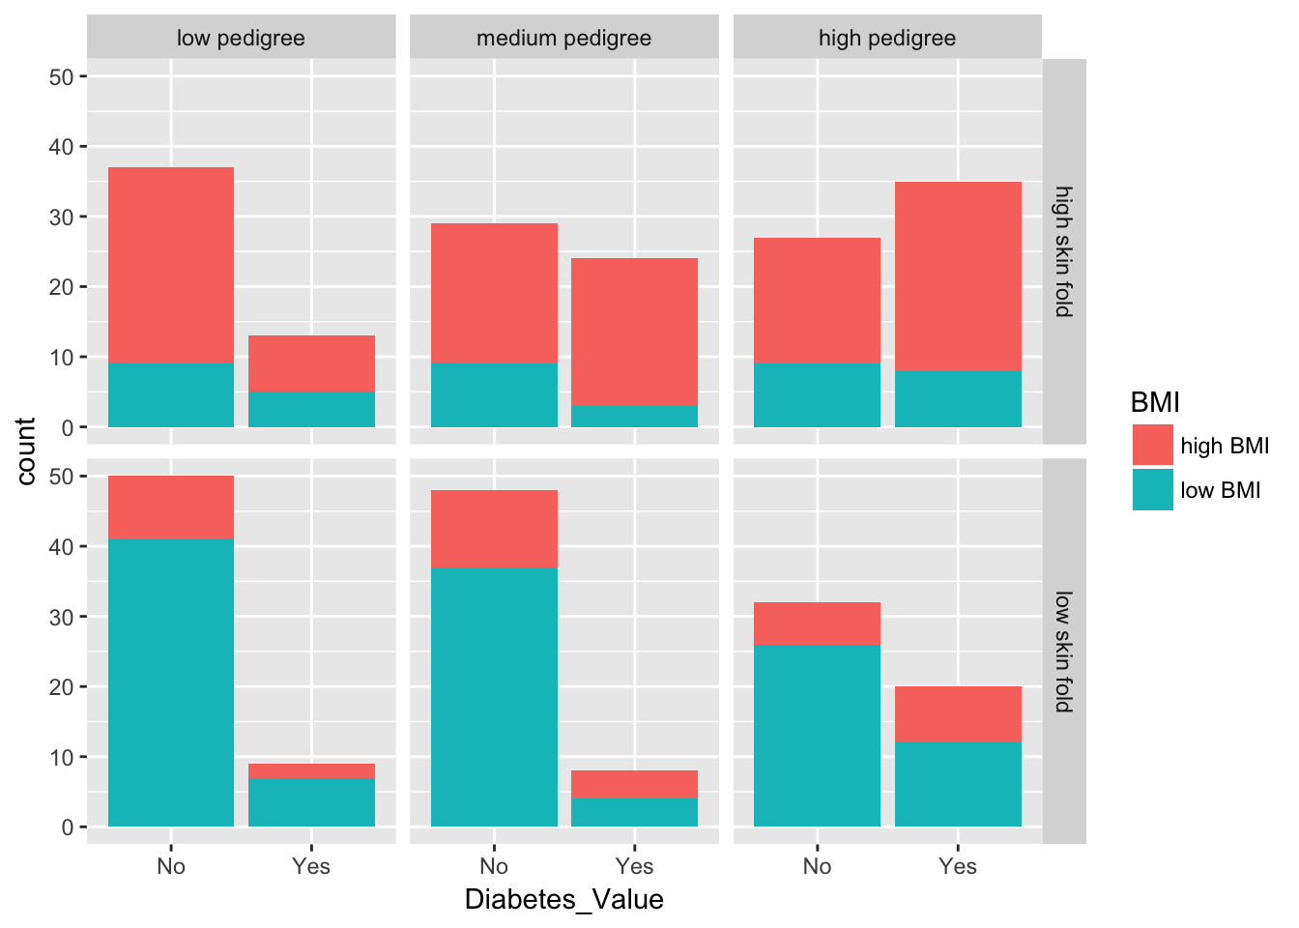
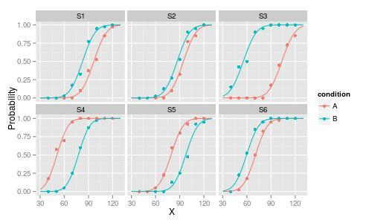
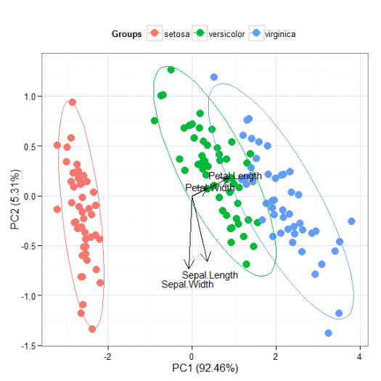
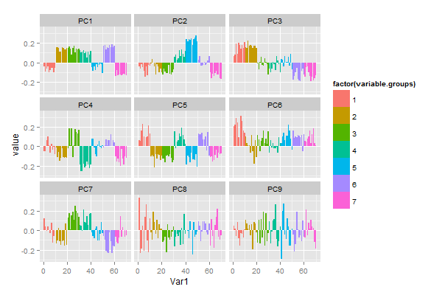
Have Seen Like This?

Slide 3
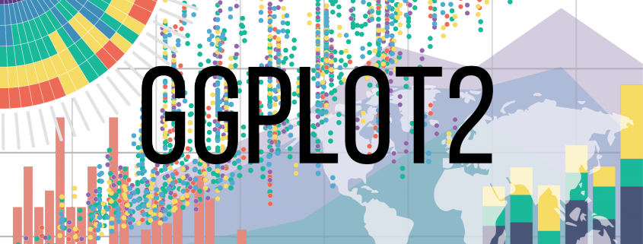
Have Seen Like This?

Slide 4
Goal
Understand and able to create data visualization using ggplot2 package
Source and code can be downloaded from
https://github.com/aephidayatuloh/DataViz-Introggplot2

Slide 5
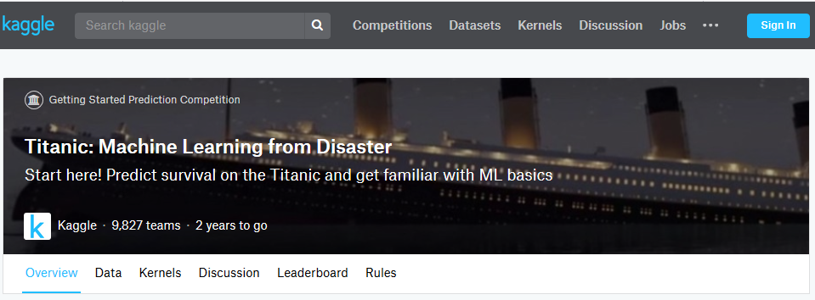
Data: Titanic
Why use this data?

Slide 6
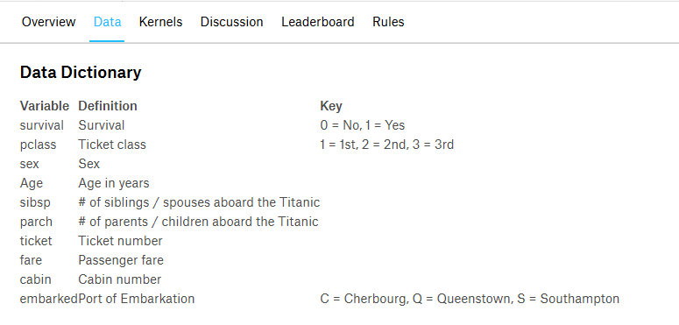
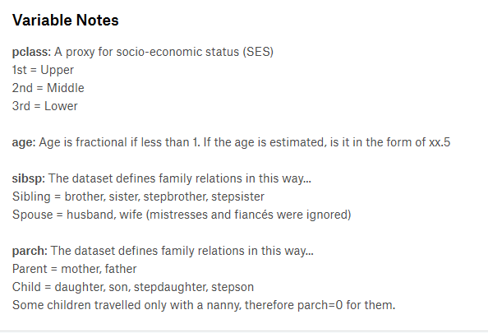
Data Dictionary
titanic <- read.csv("titanic.csv")
titanic$Survived <- factor(titanic$Survived)
titanic$Pclass <- factor(titanic$Pclass)
titanic$Embarked <- factor(titanic$Embarked)

Slide 7
Why ggplot2?

Slide 8
ggplot2
ggplot2 : grammar of graphics
install.packages("ggplot2")
library(ggplot2)

Slide 9
qplot()
qplot : quick plot
qplot(x, y = NULL, ..., data, facets = NULL,
margins = FALSE, geom = "auto", xlim = c(NA, NA), ylim = c(NA, NA), log = "",
main = NULL, xlab = deparse(substitute(x)), ylab = deparse(substitute(y)),
asp = NA, stat = NULL, position = NULL)
Although called "quick", but it not famous as ggplot() and not so many people use it.

Slide 10
ggplot()
ggplot : grammar of graphics plot
Followed by “+” to add component such as :
geom_function (i.e geom_bar(), geom_histogram(), geom_density(), geom_point(), geom_boxplot(), etc.),
facet_function(i.e facet_grid(), facet_flip(), facet_null()),
labs(title, xlab, ylab, subtitle),
theme_function(i.e theme_bw(), theme_classic(), etc.).
ggplot(data = NULL, mapping = aes(), ...,
environment = parent.frame())

Slide 11
Common Ways
Three common ways to invoke ggplot:
ggplot(df, aes(x, y, <others aesthetics>))
If you will use the same dataframe and aesthetic
ggplot(df)
If you will use the same data frame but different aesthetic for every geoms.
ggplot()
If you will use different data frame or aesthetic.

Slide 12
Create Graphs

Slide 13
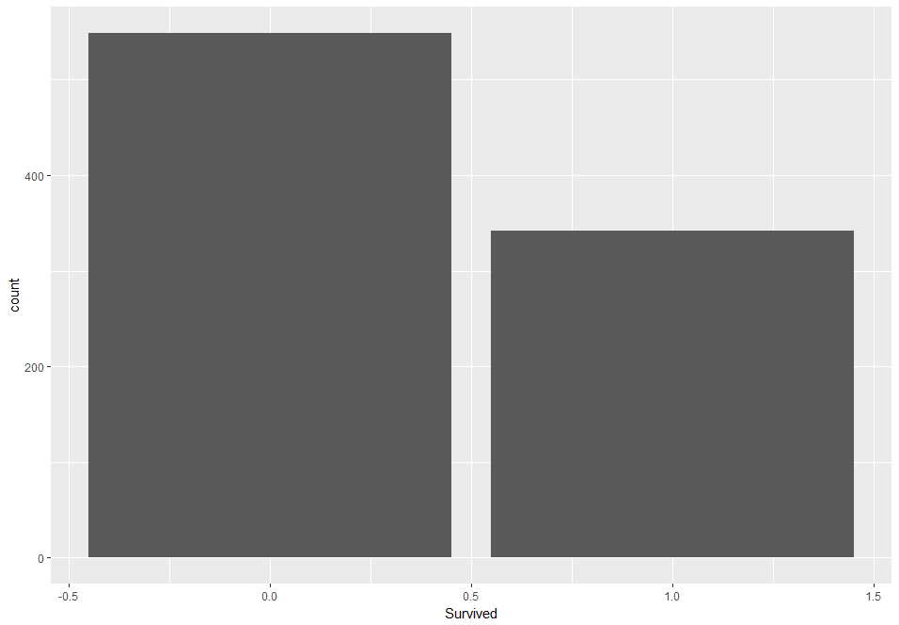
Barplot: geom_bar()
ggplot(data = titanic, aes(x = Survived)) +
geom_bar()
g <- ggplot(data = titanic,
aes(x = Survived))
g + geom_bar()
*geom: geometry

Slide 14
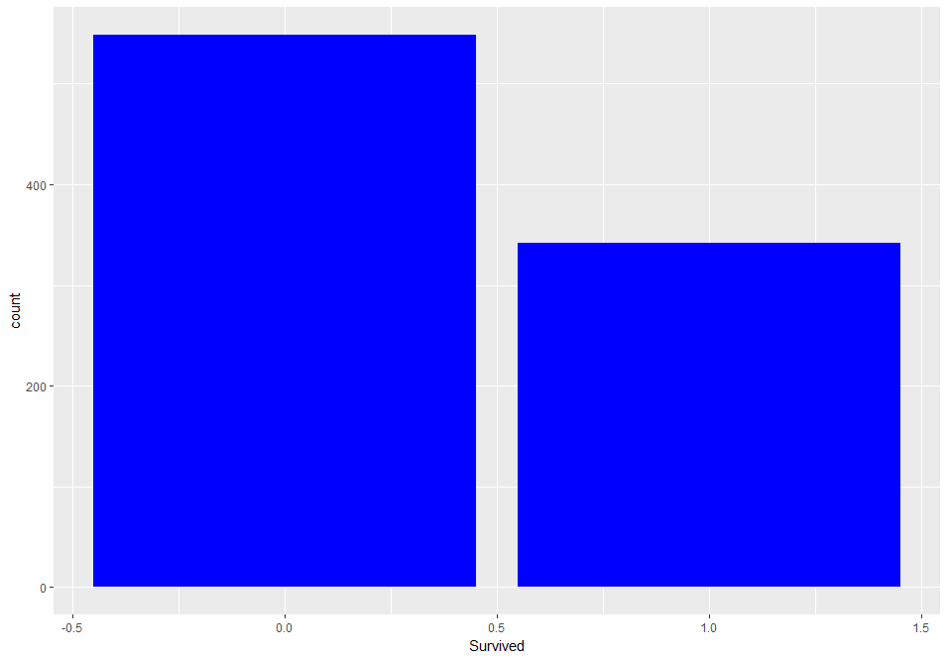
Barplot: geom_bar()
ggplot(data = titanic, aes(x = Survived)) +
geom_bar(fill = "blue")
g <- ggplot(data = titanic,
aes(x = Survived))
g + geom_bar(fill = "blue")

Slide 15
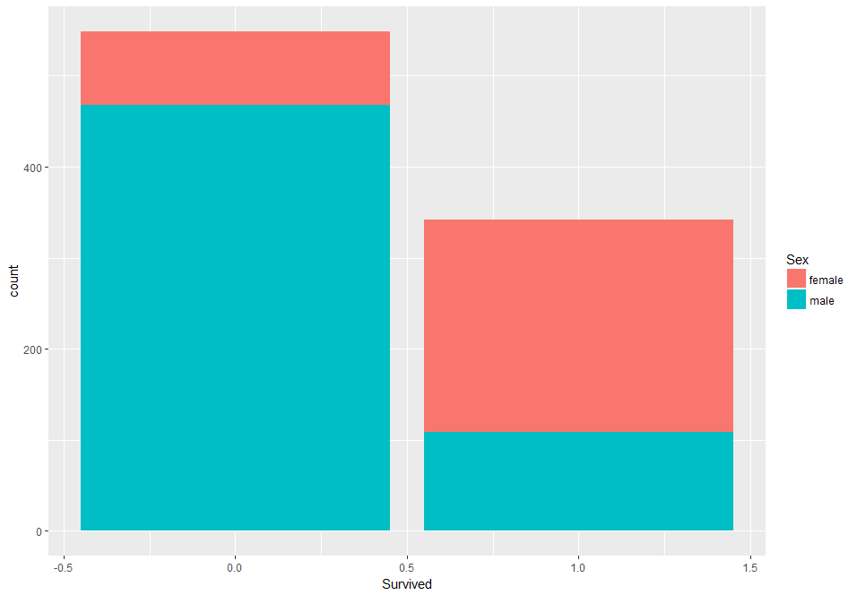
Barplot: geom_bar()
ggplot(data = titanic, aes(x = Survived, fill = Sex)) +
geom_bar()
g <- ggplot(data = titanic,
aes(x = Survived))
g + geom_bar(aes(fill = Sex))

Slide 16
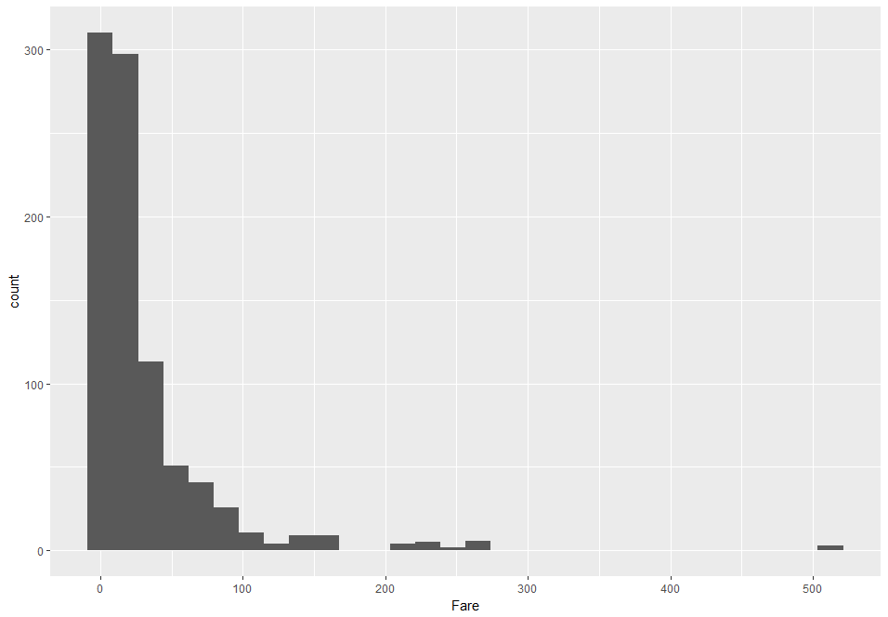
Histogram: geom_histogram()
ggplot(data = titanic, aes(x = Fare)) +
geom_histogram()

Slide 17
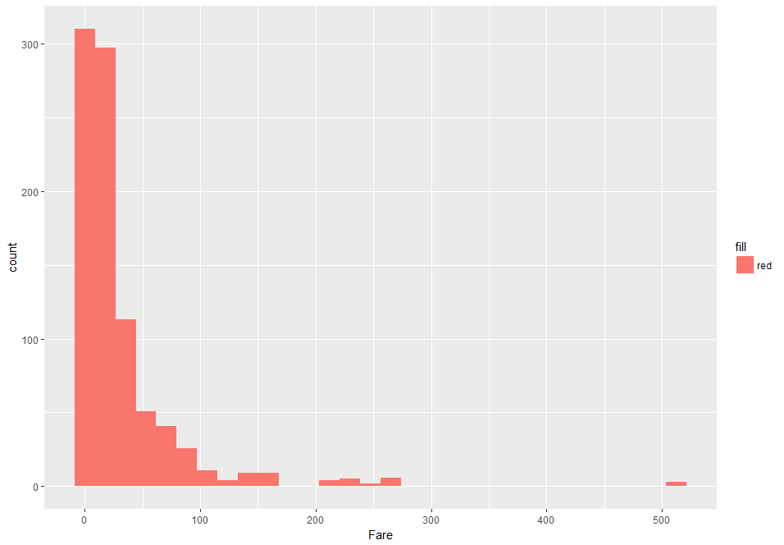
Histogram: geom_histogram()
ggplot(data = titanic, aes(x = Fare, fill = "red")) +
geom_histogram()
g <- ggplot(data = titanic,
aes(x = Fare))
g + geom_histogram(fill = "red")

Slide 18
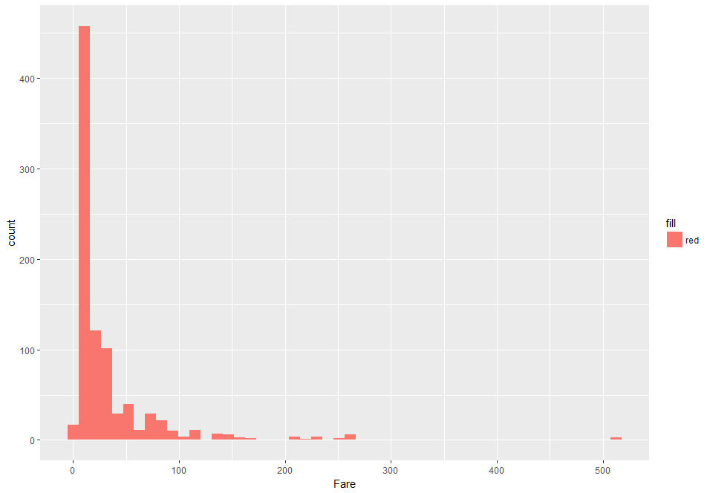
Histogram: geom_histogram()
ggplot(data = titanic, aes(x = Fare, fill = "red")) +
geom_histogram(bins = 50)
g <- ggplot(data = titanic,
aes(x = Fare))
g + geom_histogram(fill = "red",
bins = 50)

Slide 19
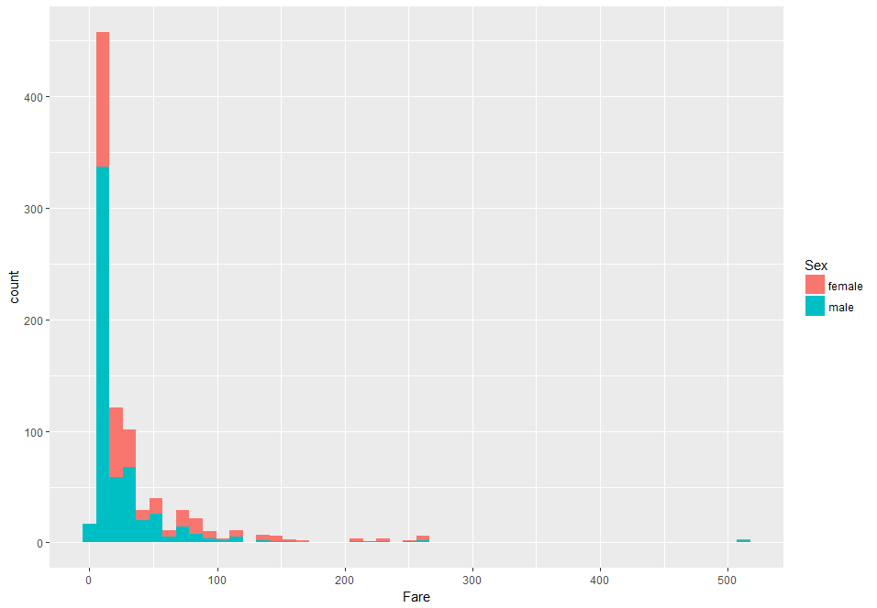
Histogram: geom_histogram()
ggplot(data = titanic, aes(x = Fare, fill = Sex)) +
geom_histogram(bins = 50)
g <- ggplot(data = titanic,
aes(x = Fare))
g + geom_histogram(aes(fill = Sex),
bins = 50)

Slide 20
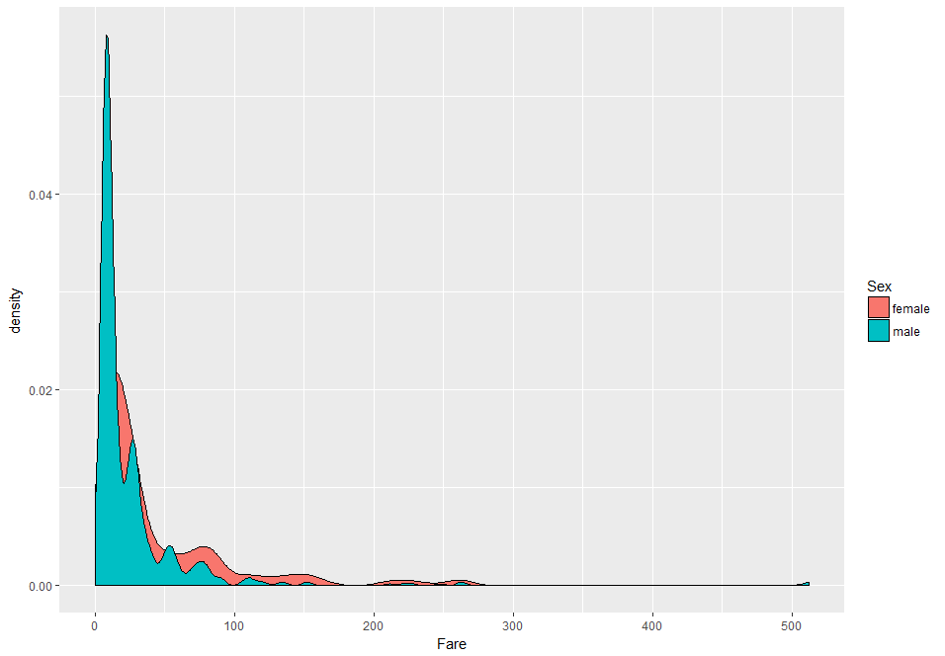
Density: geom_density()
ggplot(data = titanic, aes(x = Fare, fill = Sex)) +
geom_density()
g <- ggplot(data = titanic,
aes(x = Fare, fill = Sex))
g + geom_density()

Slide 21
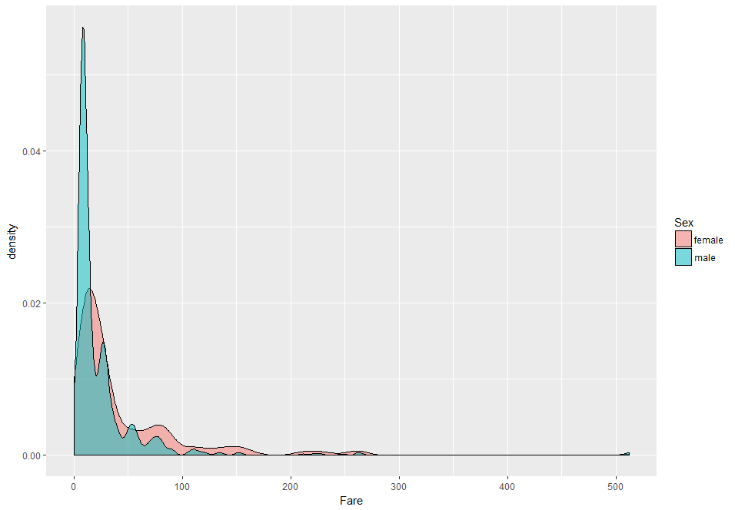
Density: geom_density()
ggplot(data = titanic, aes(x = Fare, fill = Sex)) +
geom_density(alpha = 0.5)
g <- ggplot(data = titanic,
aes(x = Fare, fill = Sex))
g + geom_density(alpha = 0.5)

Slide 22
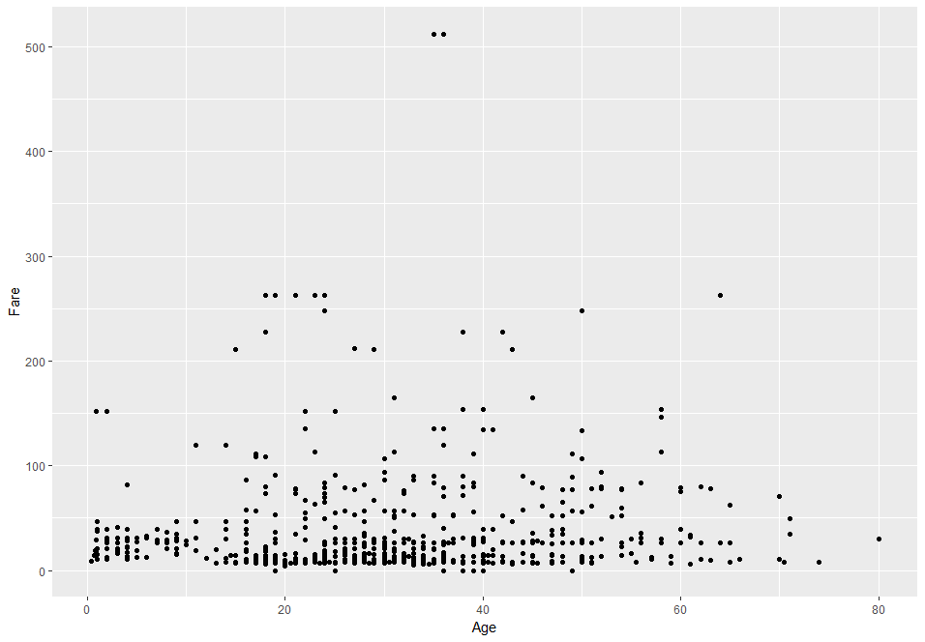
Scatter: geom_point()
ggplot(data = titanic, aes(x = Age, y = Fare)) +
geom_point()
g <- ggplot(data = titanic,
aes(x = Age, y = Fare))
g + geom_point()

Slide 23
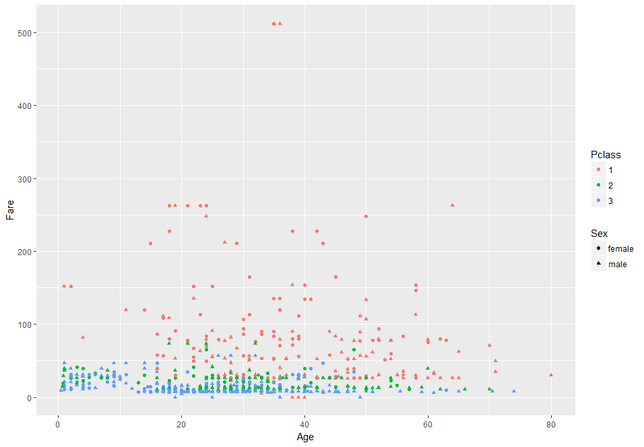
Scatter: geom_point()
ggplot(data = titanic, aes(x = Age, y = Fare, col = Survived)) +
geom_point(aes(col = Survived, shape = Sex))
g <- ggplot(data = titanic,
aes(x = Age, y = Fare))
g + geom_point(aes(col = Survived,
shape = Sex))

Slide 24
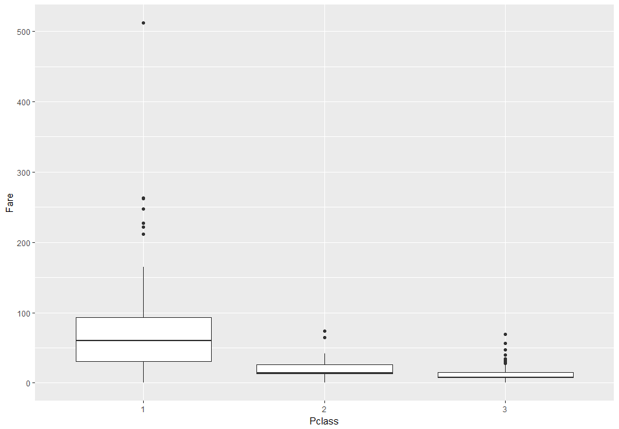
Boxplot: geom_boxplot()
ggplot(data = titanic, aes(x = Pclass, y = Fare)) +
geom_boxplot()
Note: different from basic R boxplot which you can plot a single continuous variable, geom_boxplot is used to compare continuous variable by categorical/group variable.
 | X | Y
Basic boxplot() | Need | No need
geom_boxplot() | Need | Need

Slide 25
Faceting

Slide 26
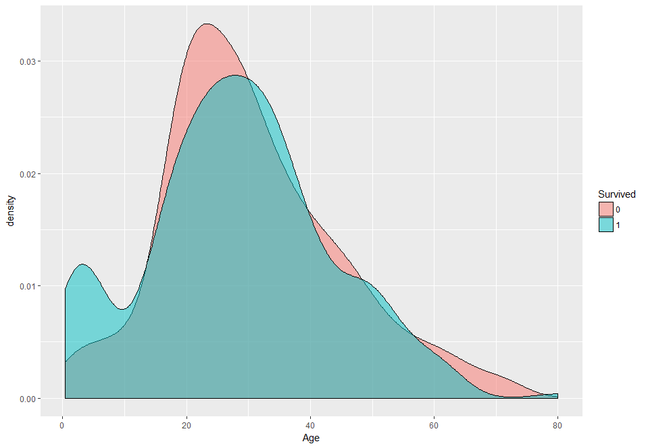
Faceting
ggplot(data = titanic, aes(x = Age, fill = Survived)) +
geom_density(alpha 0.5)
The film told us that females, children’s and old peoples was priority to save. How to know?

Slide 27
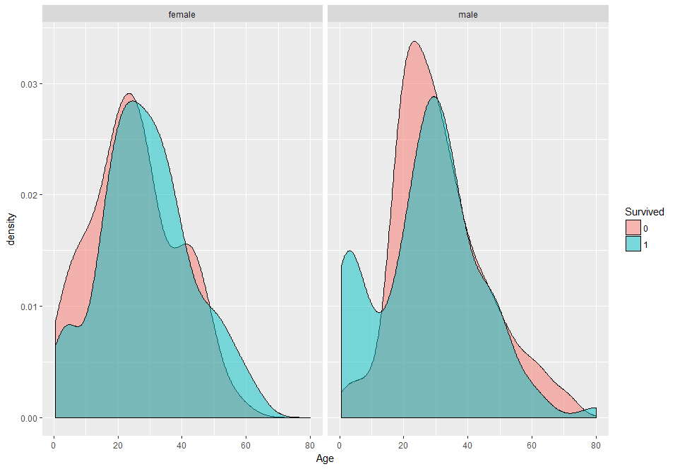
Faceting: facet_wrap()
ggplot(data = titanic, aes(x = Age, fill = Survived)) +
geom_density(alpha 0.5) + facet_wrap(~Sex)

Slide 28
Faceting: facet_grid()
ggplot(data = titanic, aes(x = Age, fill = Survived)) +
geom_density(alpha 0.5) + facet_grid(~Sex)

Slide 29
Faceting: Difference?
ggplot(data = titanic, aes(x = Age, fill = Survived)) +
geom_density(alpha 0.5) + facet_wrap(Sex ~ .)
Error in combine_vars(data, params$plot_env, vars, drop = params$drop) :
At least one layer must contain all variables used for facetting

Slide 30
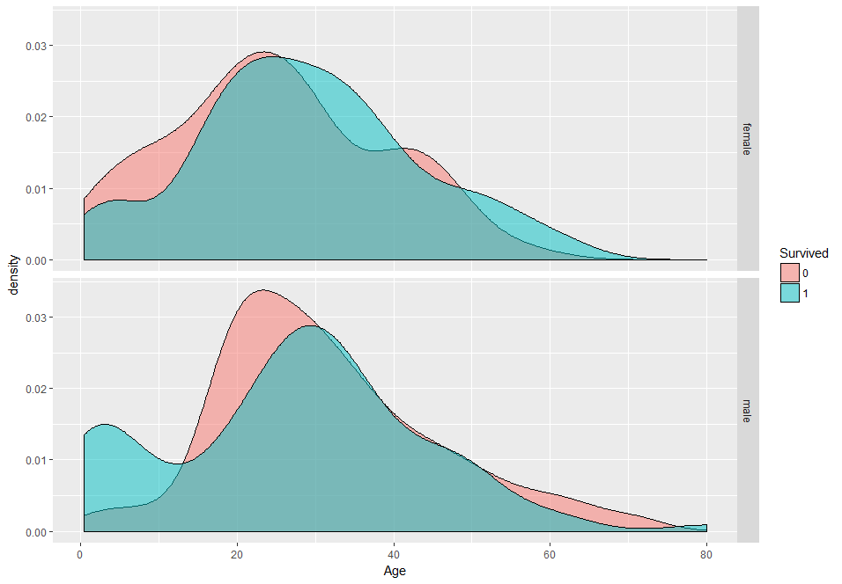
Faceting: Difference?
ggplot(data = titanic, aes(x = Age, fill = Survived)) +
geom_density(alpha 0.5) + facet_grid(Sex ~ .)

Slide 31
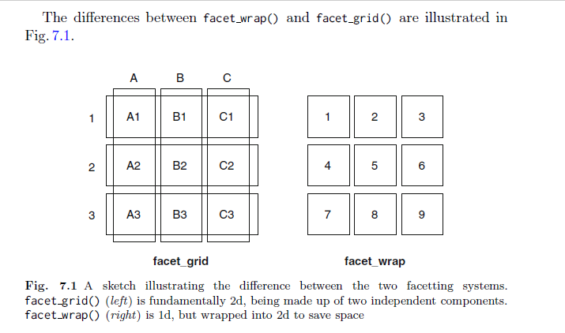
Faceting: Difference?

Slide 32
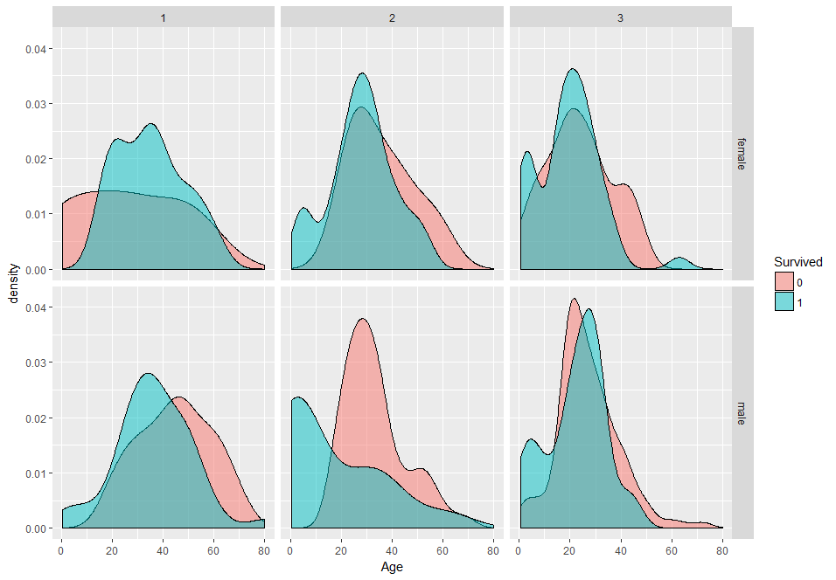
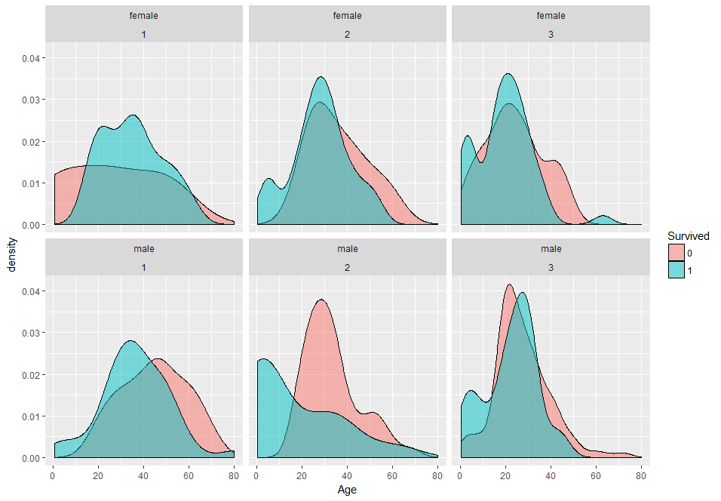
Faceting: Difference?
facet_grid(Sex ~ Pclass)
facet_wrap(Sex ~ Pclass)

Slide 33
Set up Title and Axis Labels

Slide 34
Annotations
g <- ggplot(data = titanic, aes(x = Age, fill = Survived)) +
geom_density(alpha 0.5) + facet_grid(Sex ~ .)
g

Slide 35
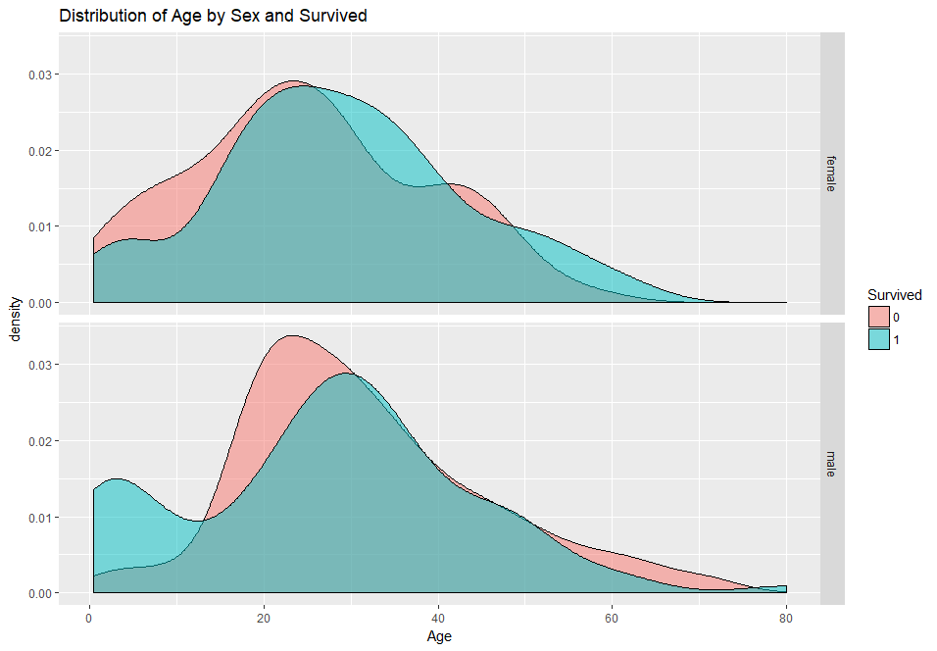
Annotations
g + labs(title = "Distribution of Age by Sex and Survived")

Slide 36
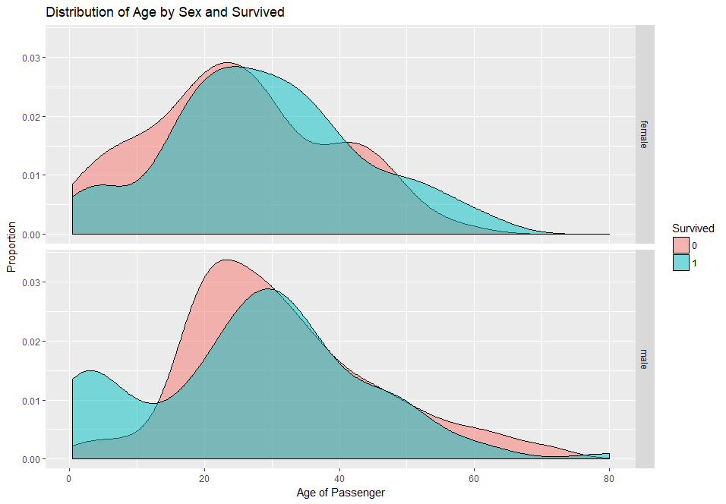
Annotations
g + labs(title = "Distribution of Age by Sex and Survived",
x = "Age of Passenger", y = "Proportion")

Slide 37
Theme

Slide 38
Theme: theme_grey()
z <- g + labs(title = "Distribution of Age by Sex and Survived",
x = "Age of Passenger", y = "Proportion")
z + theme_grey() #default theme

Slide 39
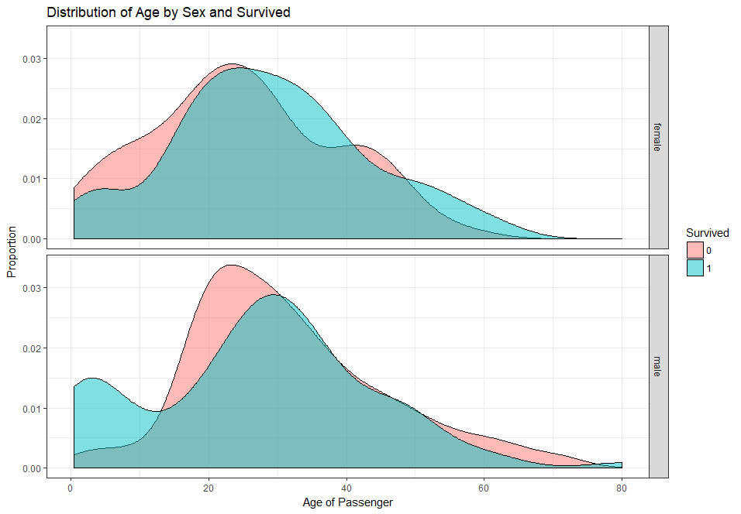
Theme: theme_bw()
z + theme_bw()

Slide 40
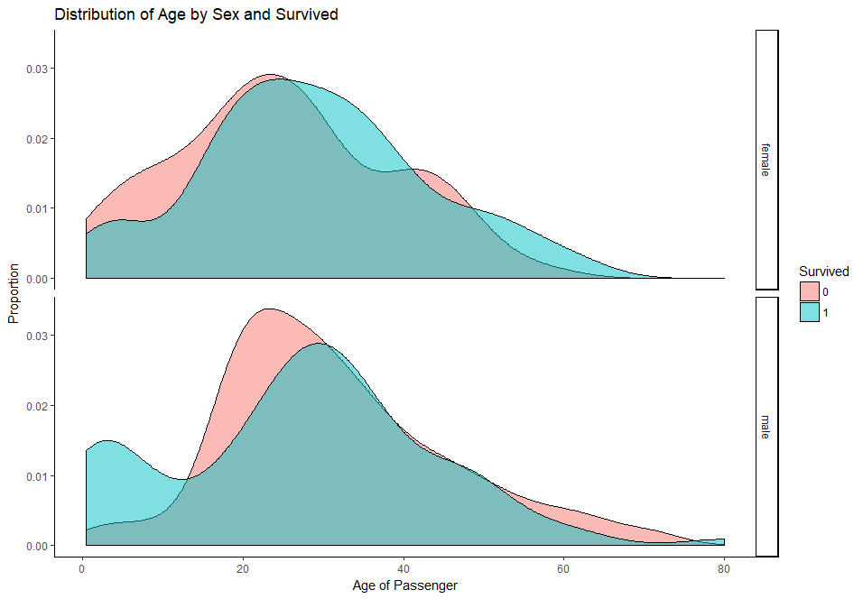
Theme: theme_classic()
z + theme_classic()

Slide 41
Theme: theme_classic()
z + theme_classic()

Slide 42
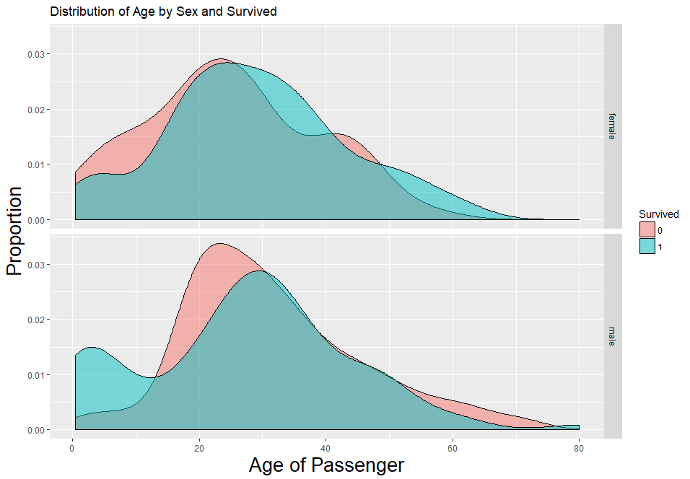
Theme: theme()
z + theme(axis.title = element_text(size = 20))

Slide 43
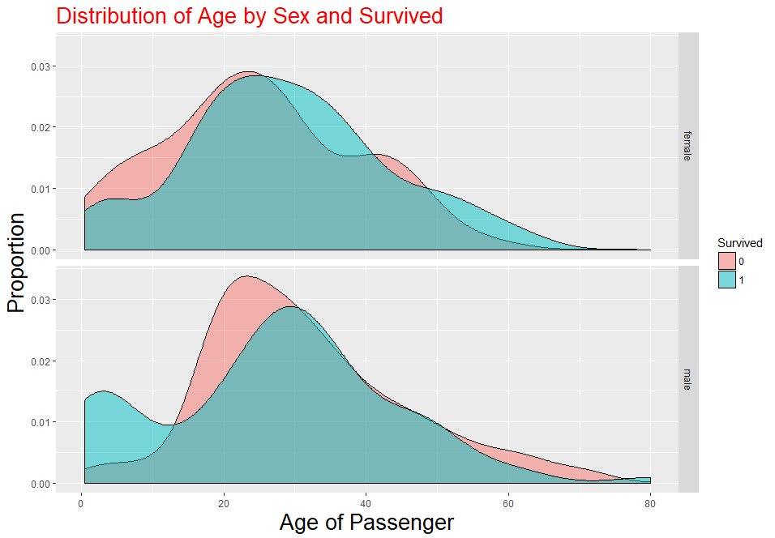
Theme: theme()
z + theme(axis.title = element_text(size = 20),
plot.title = element_text(colour = "red", size = 20))

Slide 44
Save: ggsave()
z + theme(axis.title = element_text(size = 20),
plot.title = element_text(colour = "red", size = 20))
ggsave("plotR.jpg")

Slide 45
Thank you

